Slide 1

A STUDY ON PREDICTION OF EMPLOYEE ATTRITION USING MACHINE LEARNING AT PLR PROJECTS PVT. LTD.
JAWAHARLAL NEHRU TECHNOLOGICAL UNIVERSITY ANANTAPUR,
ANANTHAPURAMU-515002
SCHOOL OF MANAGEMENT STUDIES
UNDER THE GUIDENCE OF
Dr . T. NARAYANA REDDY
HOD & PROFESSOR
SUBMITTED BY
KATARI.PAVAN
220A1E0403

Slide 2
Introduction :
HR analytics is a data-driven approach to managing people at work. HR analytics, also known as people analytics, workforce analytics, or talent analytics, it revolves around analyzing people problems using data to answer critical questions about your organization. This enable better and data-driven decision-making.
Employee attrition is defined as employees leaving their organizations for unpredictable or uncontrollable reasons. Many terms make up attrition, the most common being are termination, resignation, planned or voluntary retirement, structural changes, long-term illness, layoffs.

Slide 3

Company Profile:
Name of the organization | PLR PROJECTS PVT.LTD
Founder | P.Padmavatiamma
Founded year | 2006
Managing director | G.Swarnalatha
Turnover | 350 crores
Employees | 650
Location | Maruthi nagar, M.R palli circle, Tirupati.

Slide 4
INDUSTRY PROFILE :
The infrastructure industry encompasses a wide range of sectors crucial for societal functionality and economic development. It includes transportation (roads, bridges, airports, railways), energy (power plants, transmission lines), water and sanitation (dams, pipelines, sewage systems), and telecommunications (internet, mobile networks).
Infrastructure plays a foundational role in supporting commerce, facilitating trade, and improving living standards. In recent years, there has been a growing emphasis on sustainable infrastructure development, incorporating environmentally friendly practices and resilience against climate change impacts.
Governments worldwide are investing in infrastructure projects to stimulate economic growth, create jobs, and address aging infrastructure challenges. The India Infrastructure Sector Market size is estimated at USD 204.06 billion in 2024, and is expected to reach USD 322.27 billion by 2029, growing at a CAGR of 9.57% during the forecast period (2024-2029).

Slide 5
Need of the study :
The study on employee attrition aims to proactively identify factors influencing attrition, enabling organizations to implement targeted interventions for improved workforce management and long-term organizational success. The present study is taken for analysis of employee attrition using machine learning at PLR PROJECTS PVT.LTD.

Slide 6
Scope of the study :
The study covers to analyze employee attrition patterns, Enabling organization to optimize workforce management and foster a more engaged and stable workforce at PLR PROJECTS PVT.LTD.

Slide 7
Objective :
To study various factors contributing to employee attrition at PLR PROJECTS PVT.LTD.
To develop the predictive model to predict employee attrition at PLR PROJECTS PVT.LTD.
To analyze employee attrition at PLR PROJECTS PVT.LTD.

Slide 8
RESEARCH METHODOLOGY :
The study is based on both primary data and secondary data.
The primary data is collected through structured questionnaire.
The secondary data is collected from annual reports, website.
Website : https://www.plrprojects.com
Sampling technique : Random sampling
Sample size : 549
Methods of data analysis : Multivariant analysis

Slide 9
Hypothesis :
Null Hypothesis (H0) :
There is no significant difference between employee attrition actual values and predicted values.
Alternative Hypothesis (H1) :
There is a significant difference between employee attrition actual values and predicted values.

Slide 10
TOOLS AND TECHNIQUES :
Tool : Machine learning,
Tableau.
Techniques : Logistic regression,
Feedforward neural networks,
Random forest ,
Tableau functions.

Slide 11
Limitations :
The developed models may not give accurate results all the time.
The study is confined to employee attrition at PLR PROJECTS PVT. LTD.

Slide 12
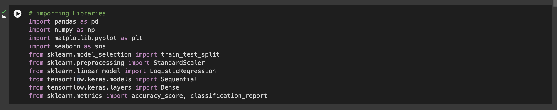
Data analysis and Interpretation :

Slide 13
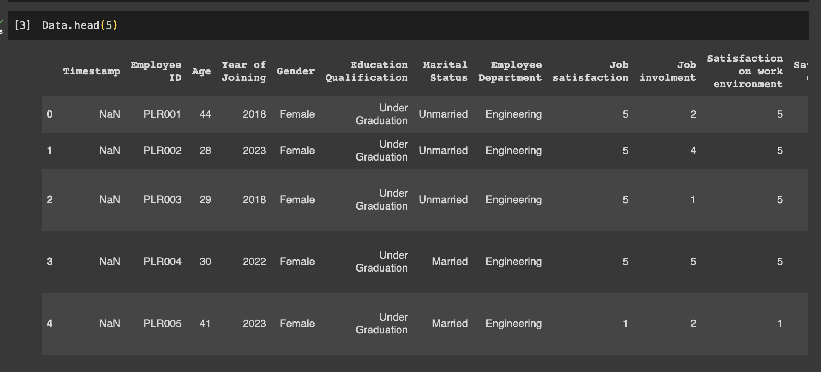
Data uploading :

Slide 14
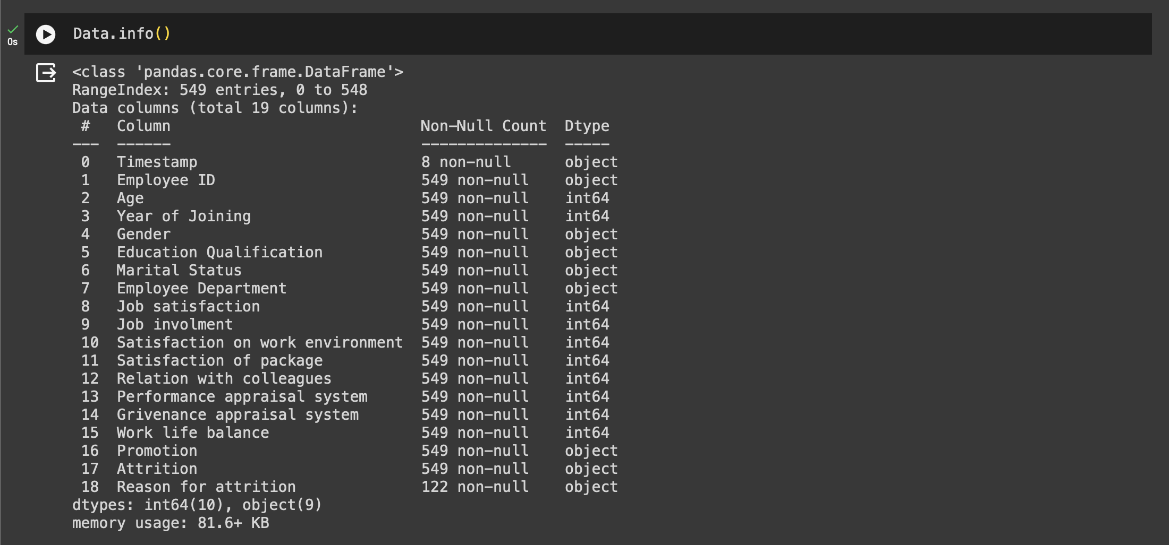

Slide 15
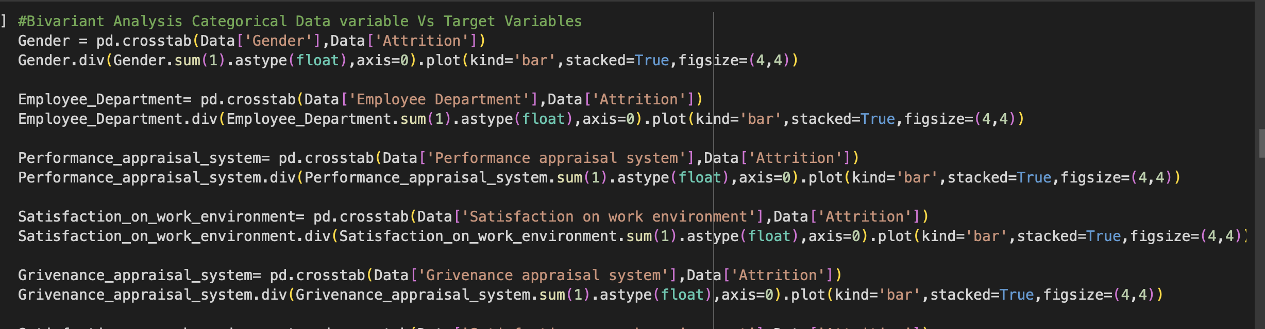
Objective-1: To study various factors contributing to employee attrition at PLR PROJECTS PVT.LTD.

Slide 16
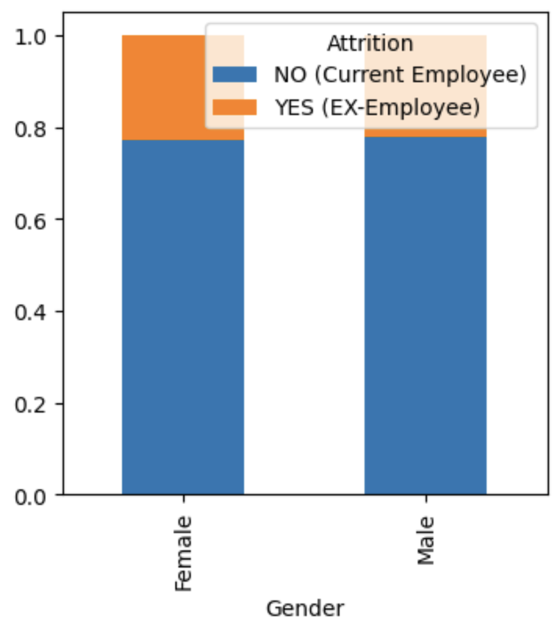
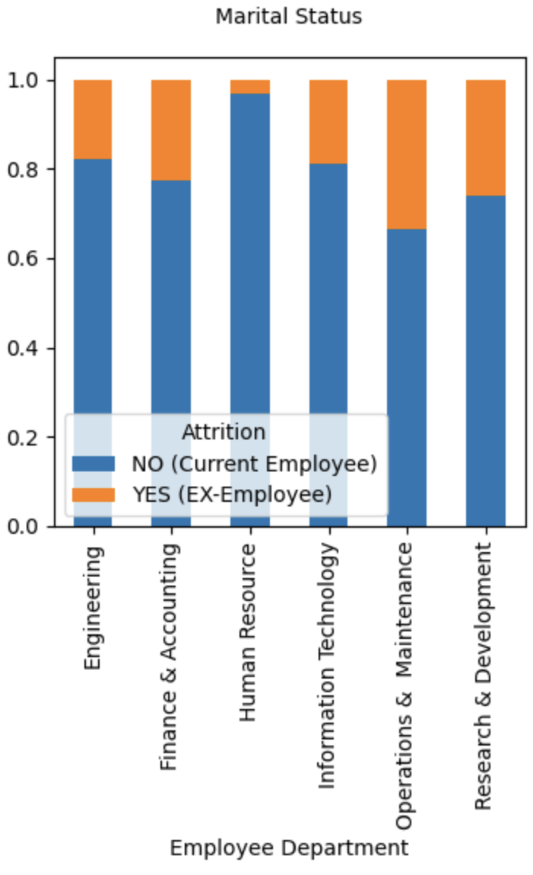
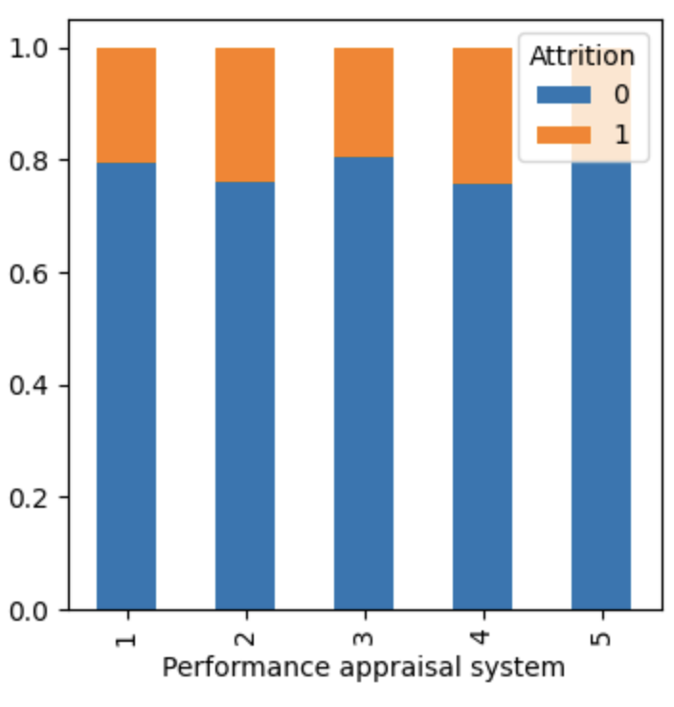
Interpretation :
From above graphs we can observe that attrition in male is high as compared to female.
Operations and maintenance department as high attrition level.
Most of the employees rated performance appraisal system with 4 and 5 rating.

Slide 17
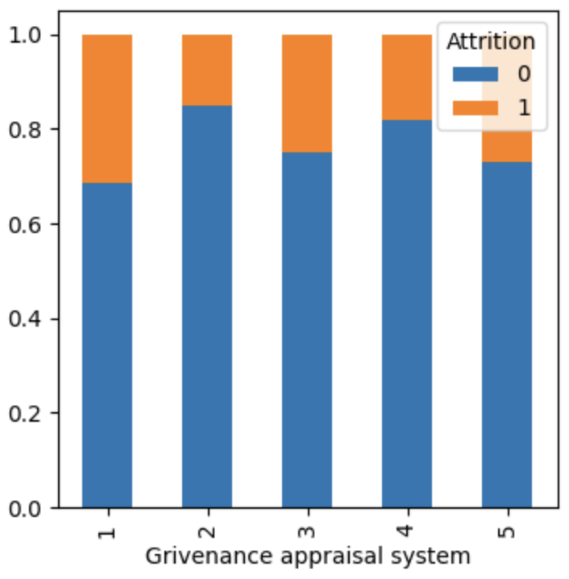
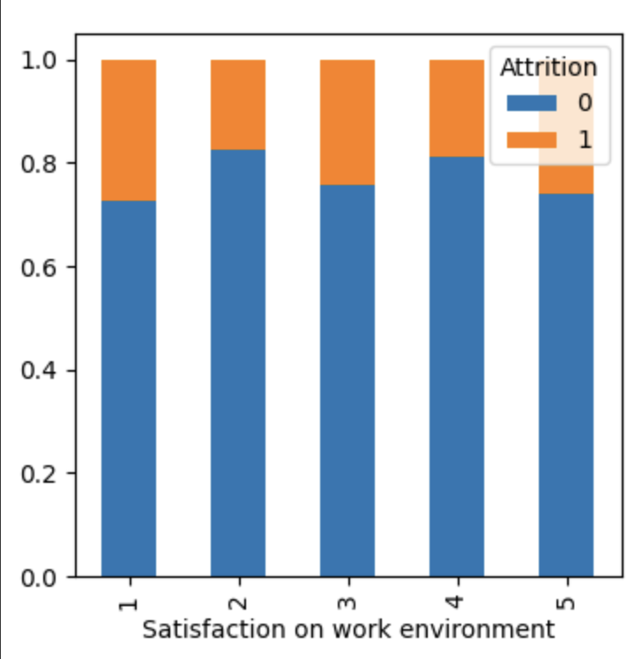
Interpretation :
From grievance appraisal system graph shows that most of the empolyees are dissatisfied and very dissatisfied with grievance appraisal system.
Most of employees rated that satisfaction on work environment as satisfied.

Slide 18
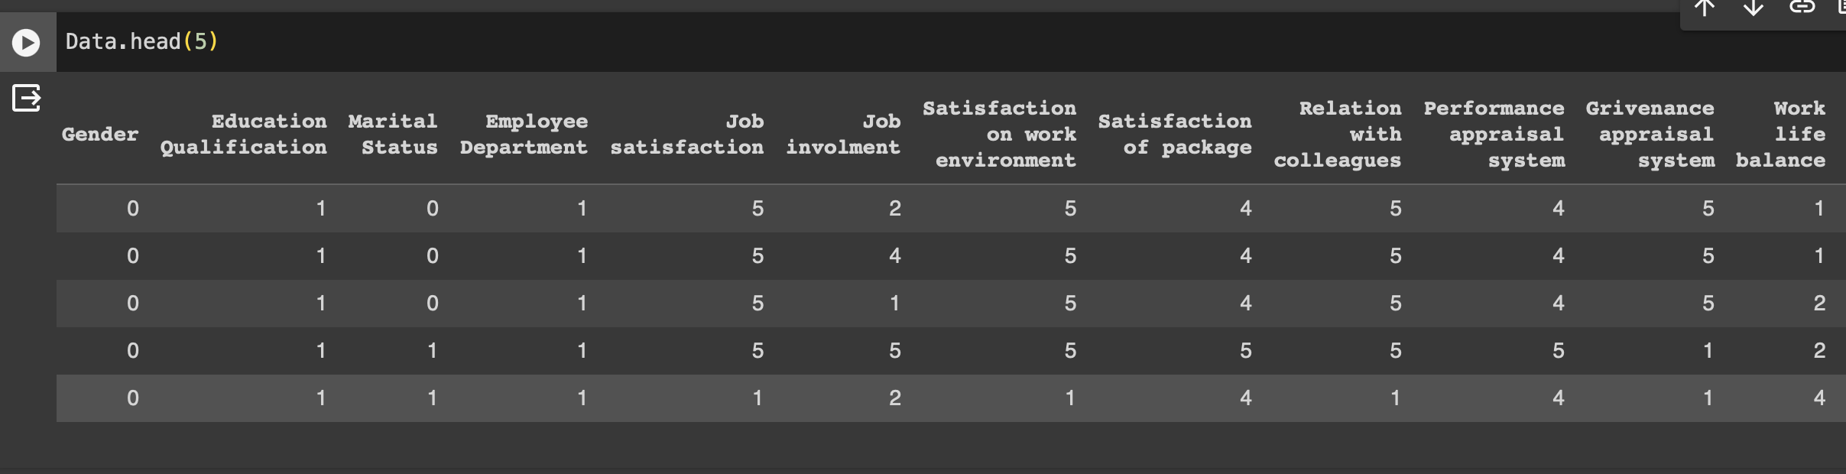
Data preprocessing :
One hat encoding categorical data:

Slide 19
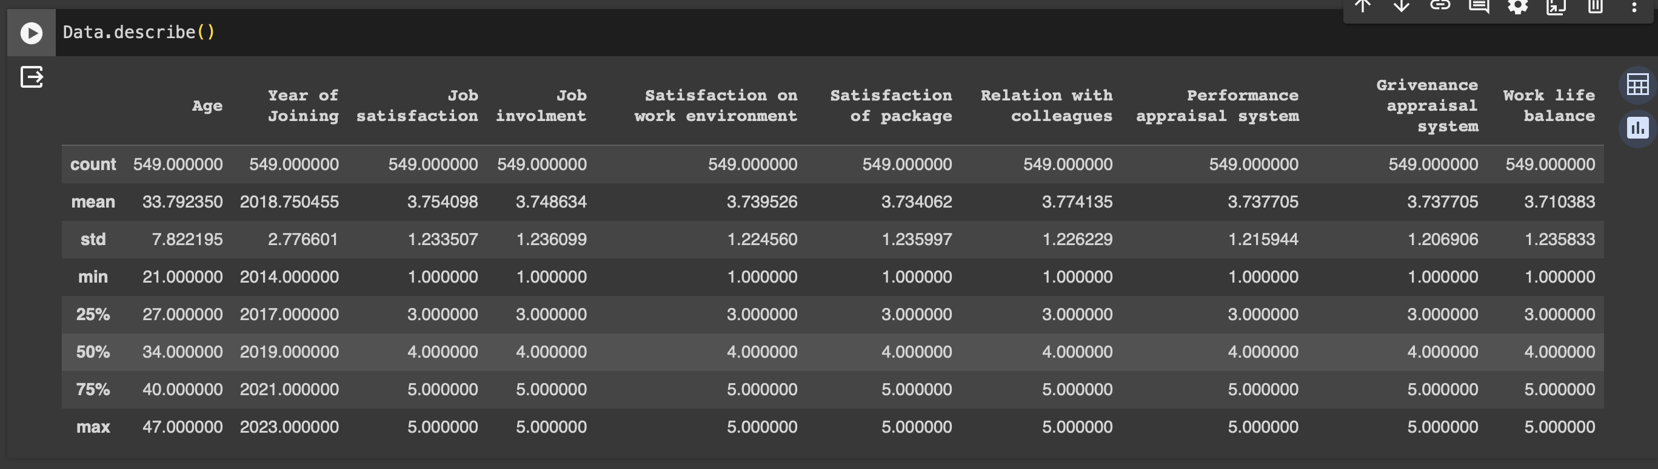
Exploratory data Analysis

Slide 20
Objective -2 :
To develop the predictive model to predict employee attrition at PLR PROJECTS PVT.LTD.

Slide 21
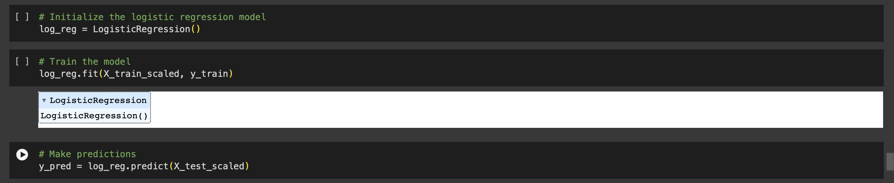
Model Building :
logistic regression

Slide 22
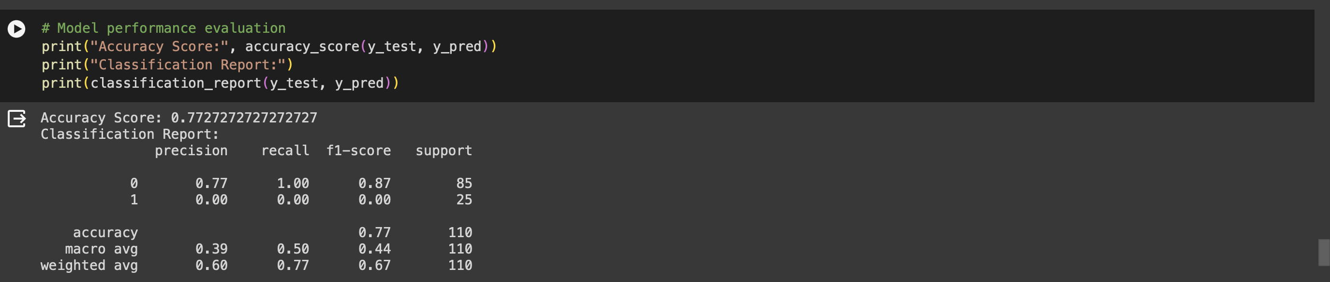
Model performance evaluation :
Interpretation :
Logistic regression model is capturing the relationship between data variables with an accuracy of 77%.

Slide 23
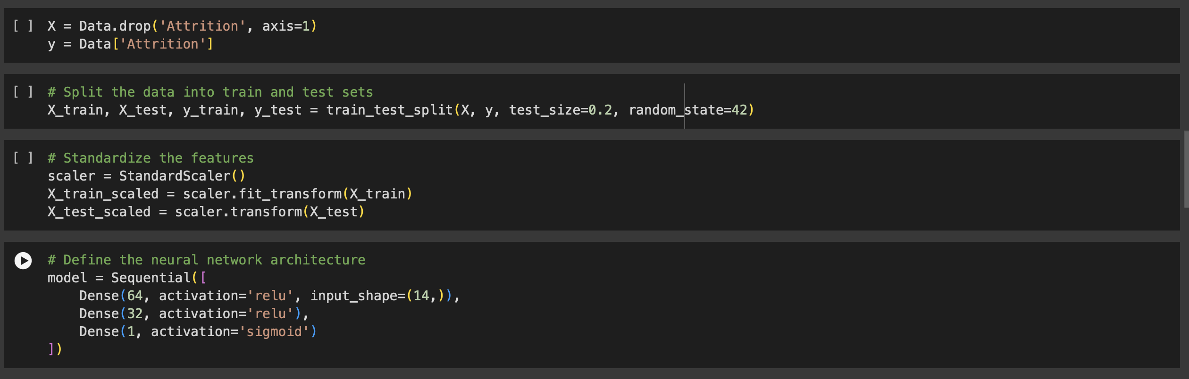
Model Building :
Feed forward neural networks

Slide 24
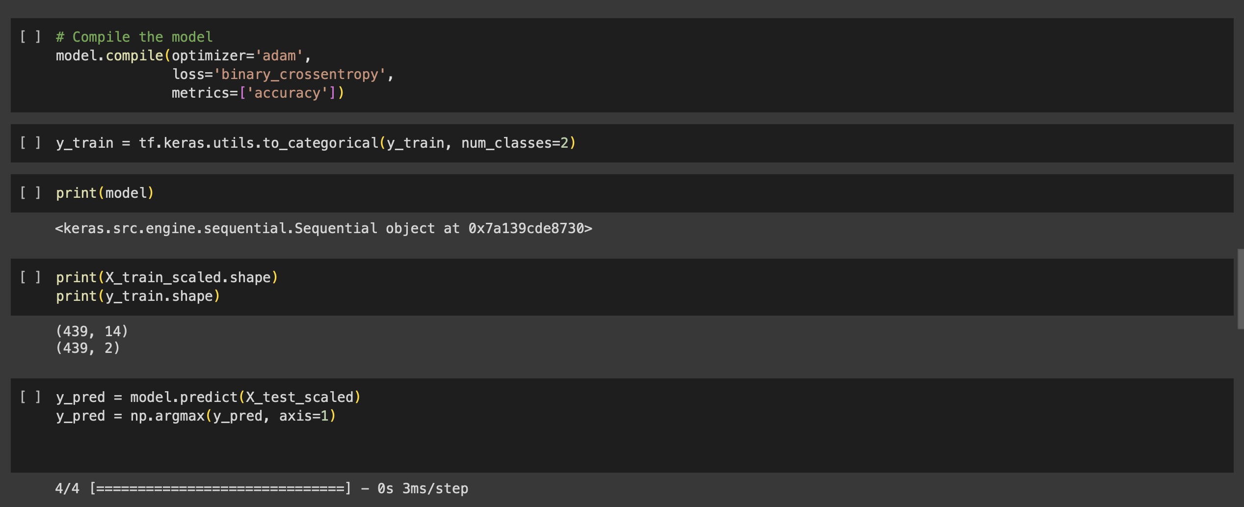

Slide 25
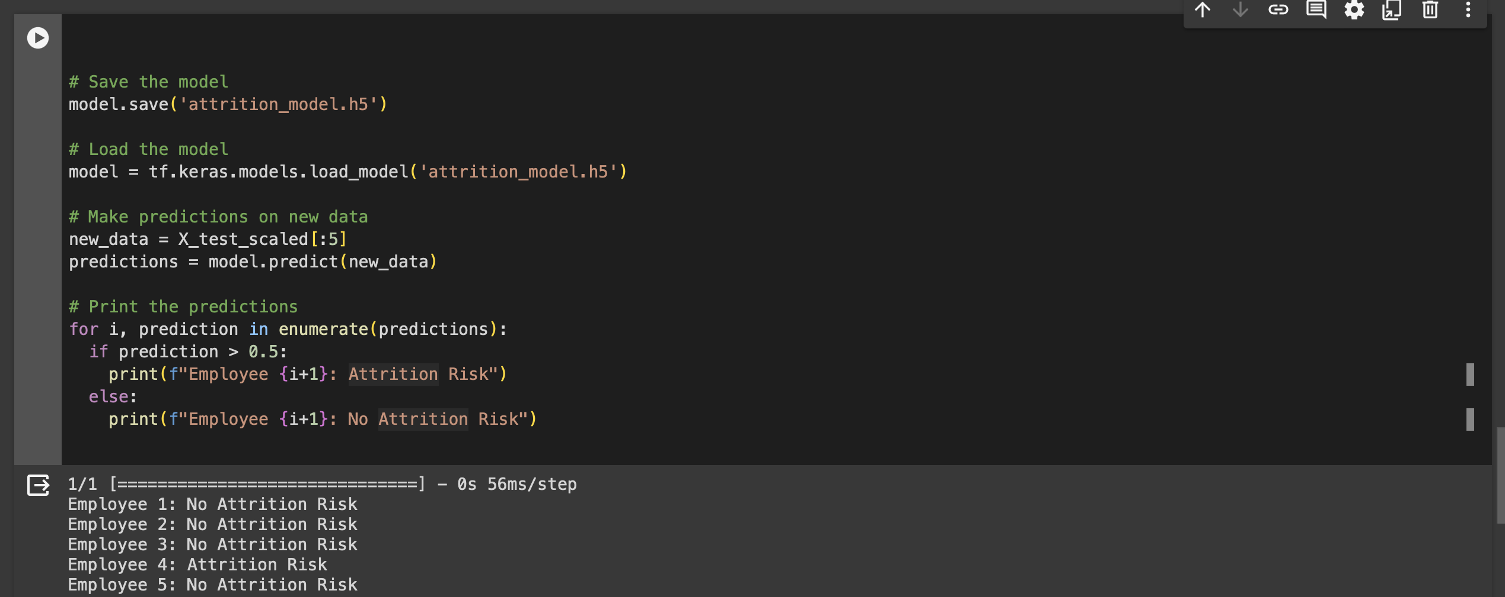

Slide 26
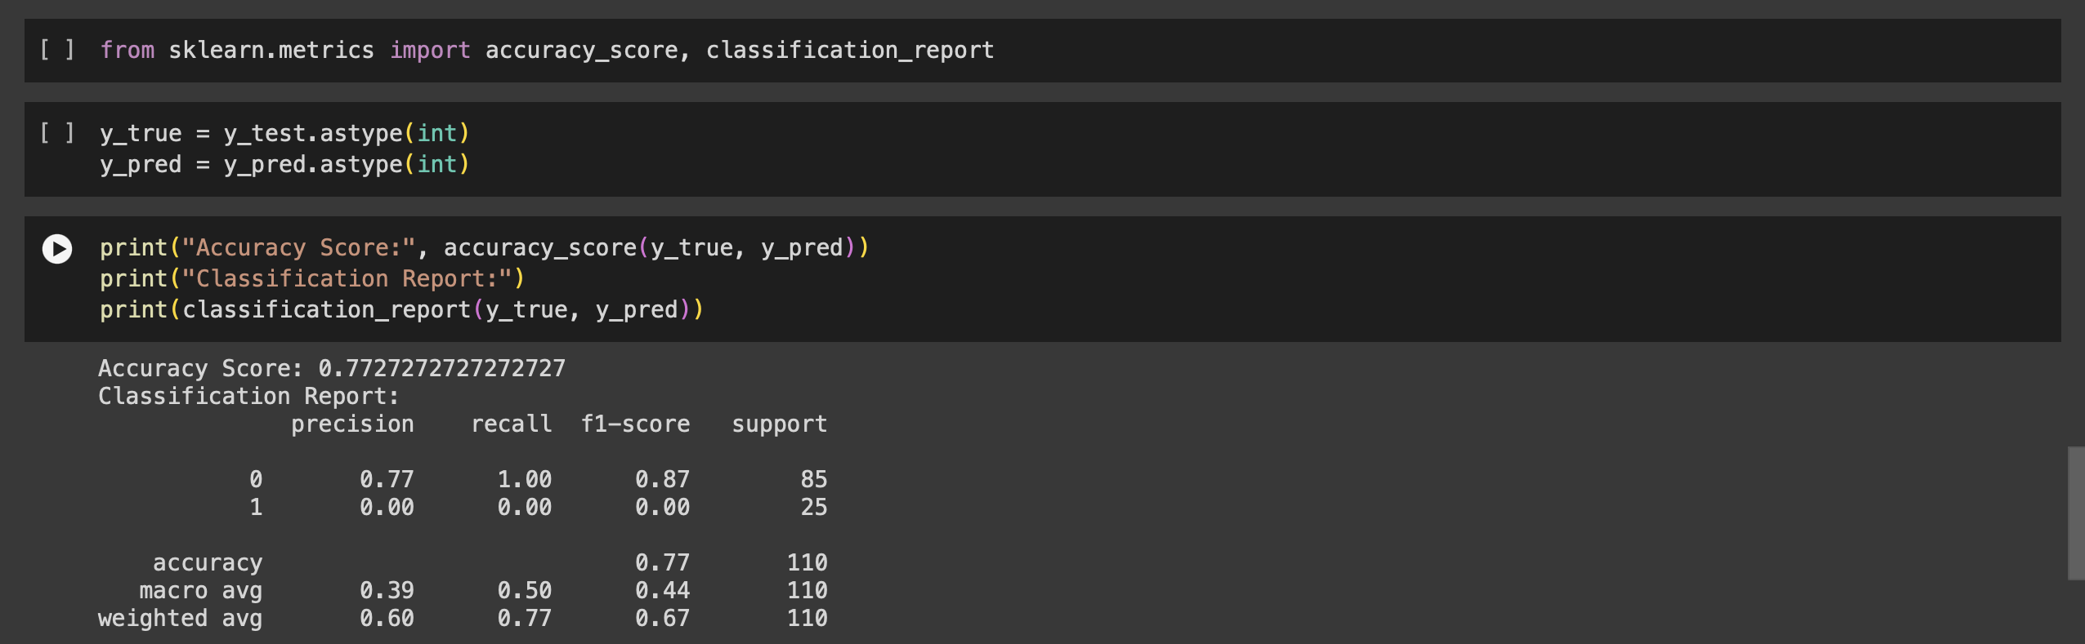
Model performance evaluation :
Interpretation :
Using of sigmoid function at outer layer gives output in binary form. Feedforward neural network gives accuracy score of 0.77% indicating that it correctly predicts outcomes for 77% of the data it was tested on.

Slide 27
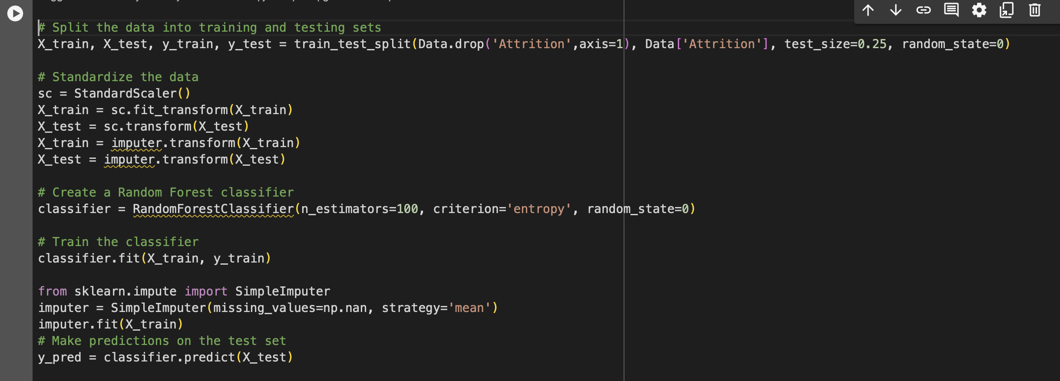
Model Building : Random forest

Slide 28
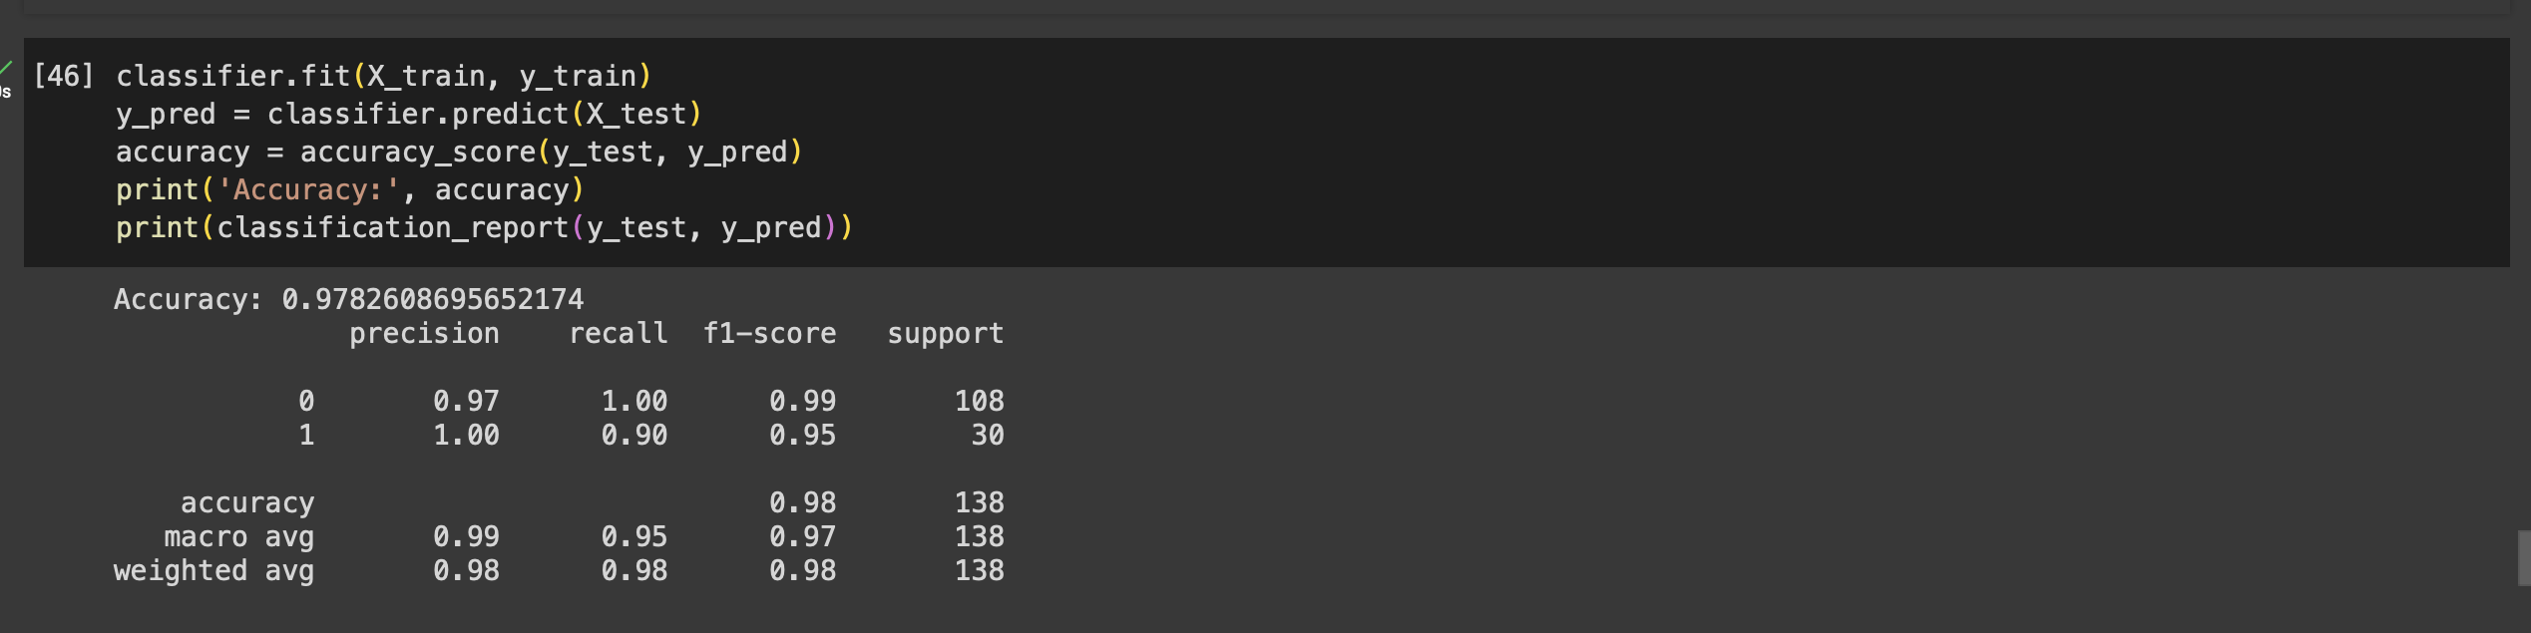
Model performance evaluation :
Interpretation :
Random forest model gives an accuracy of 97%. It means that the model is effectively capturing patterns and relationships in the data it was trained on.

Slide 29
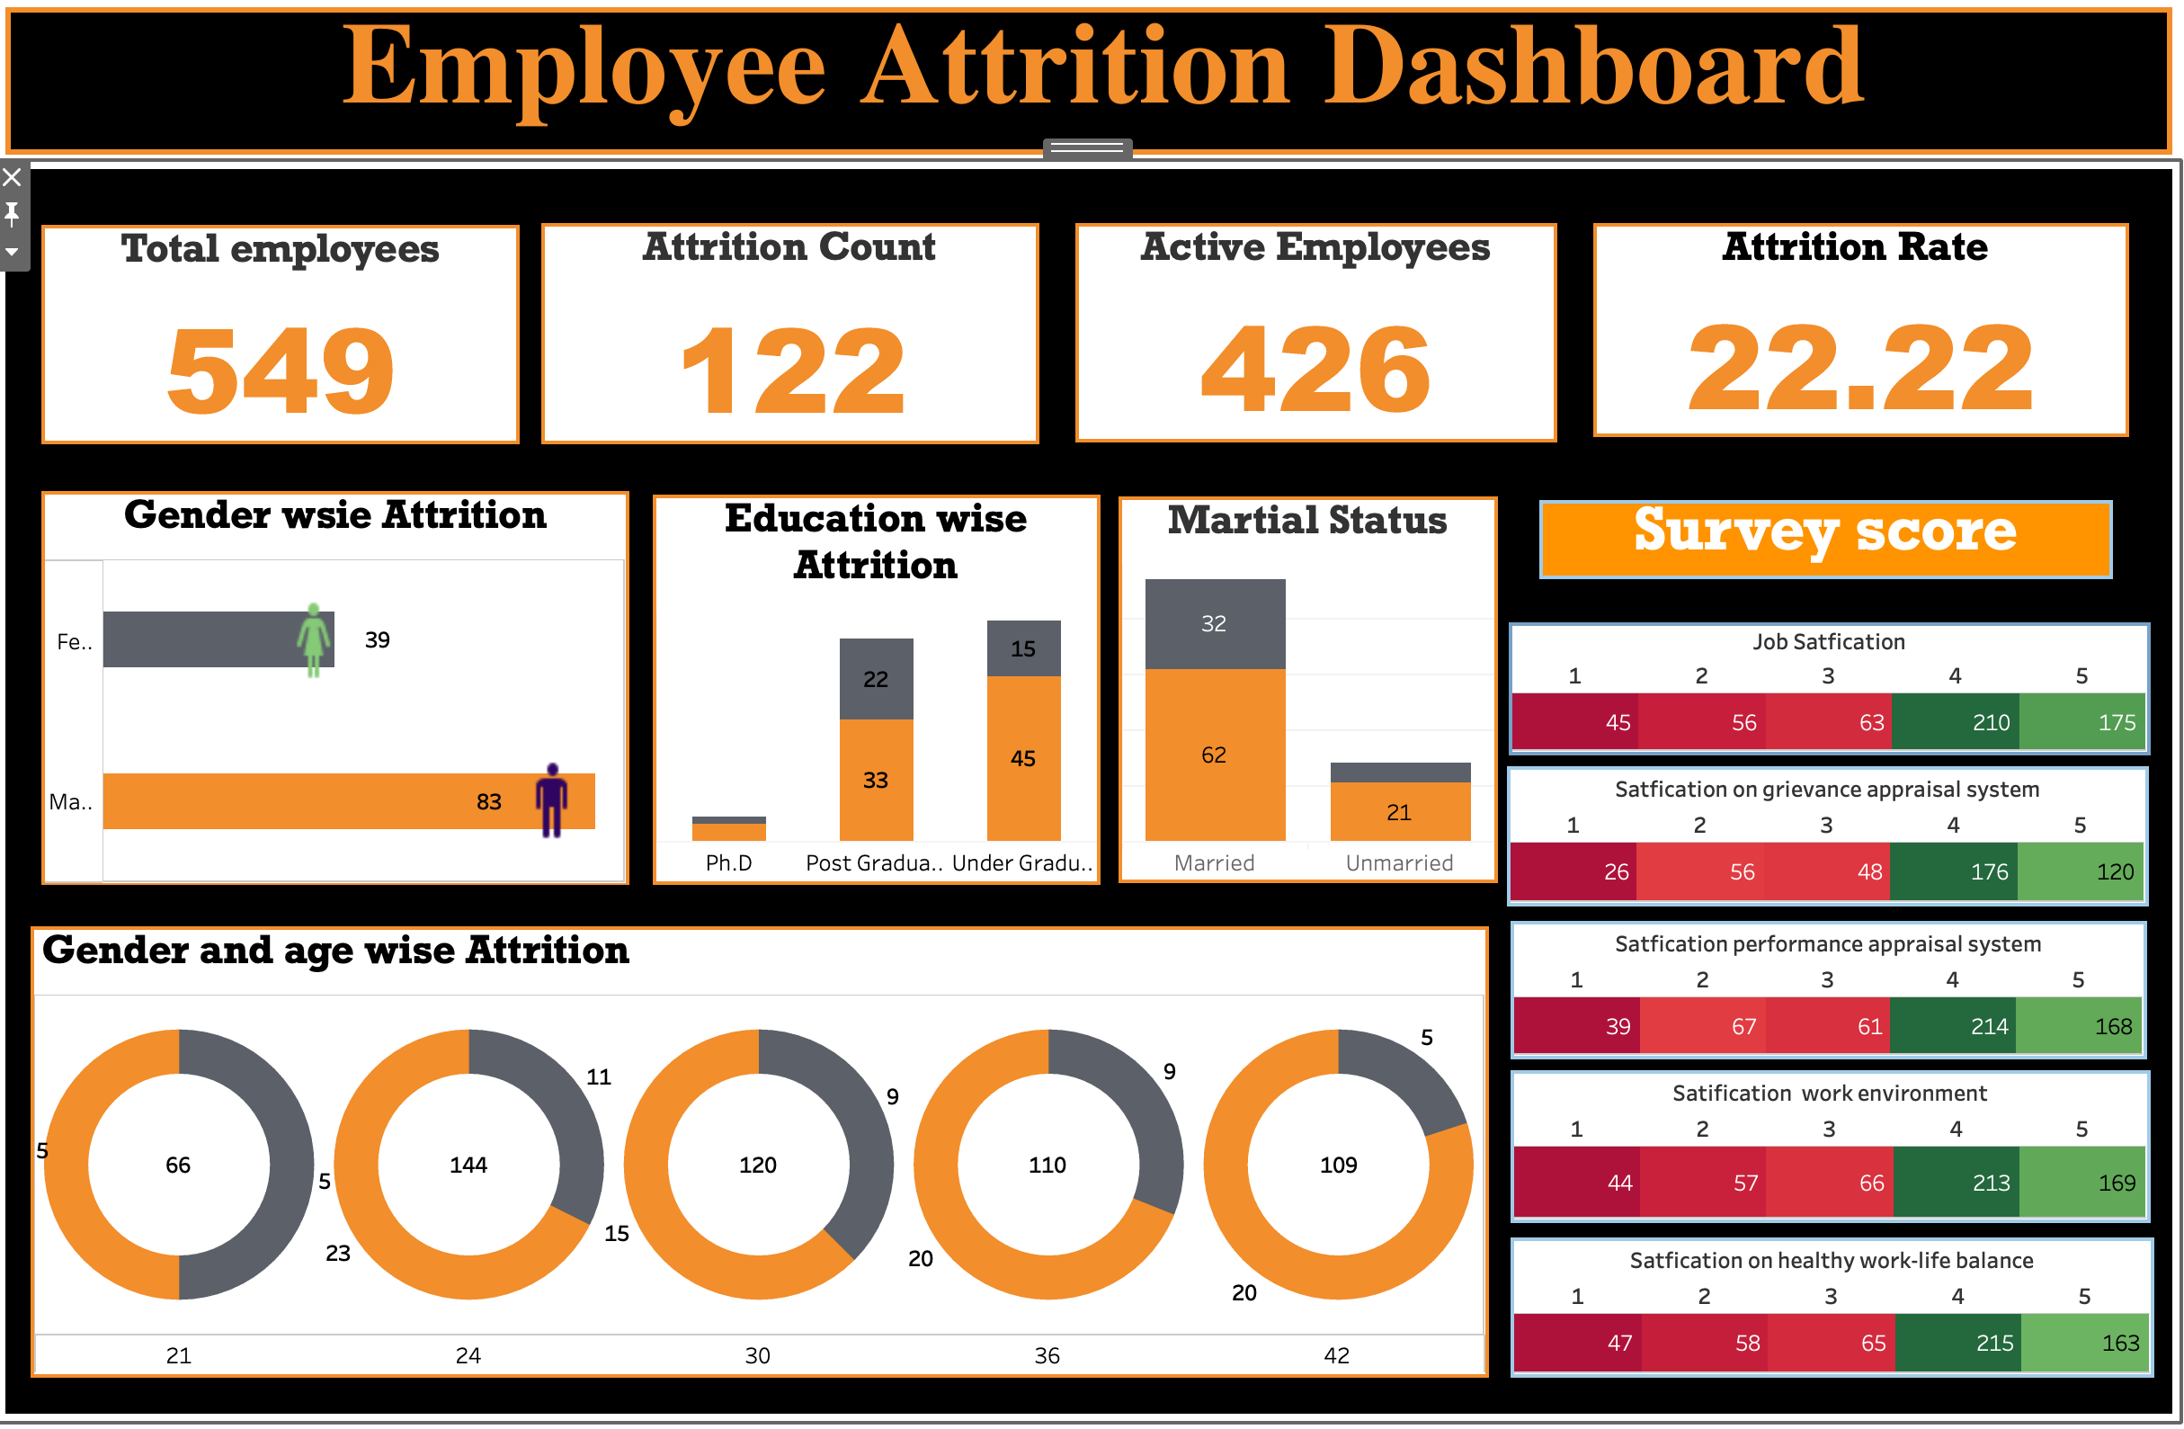
Objective -3
To analyze employee attrition at PLR PROJECTS PVT.LTD.

Slide 30
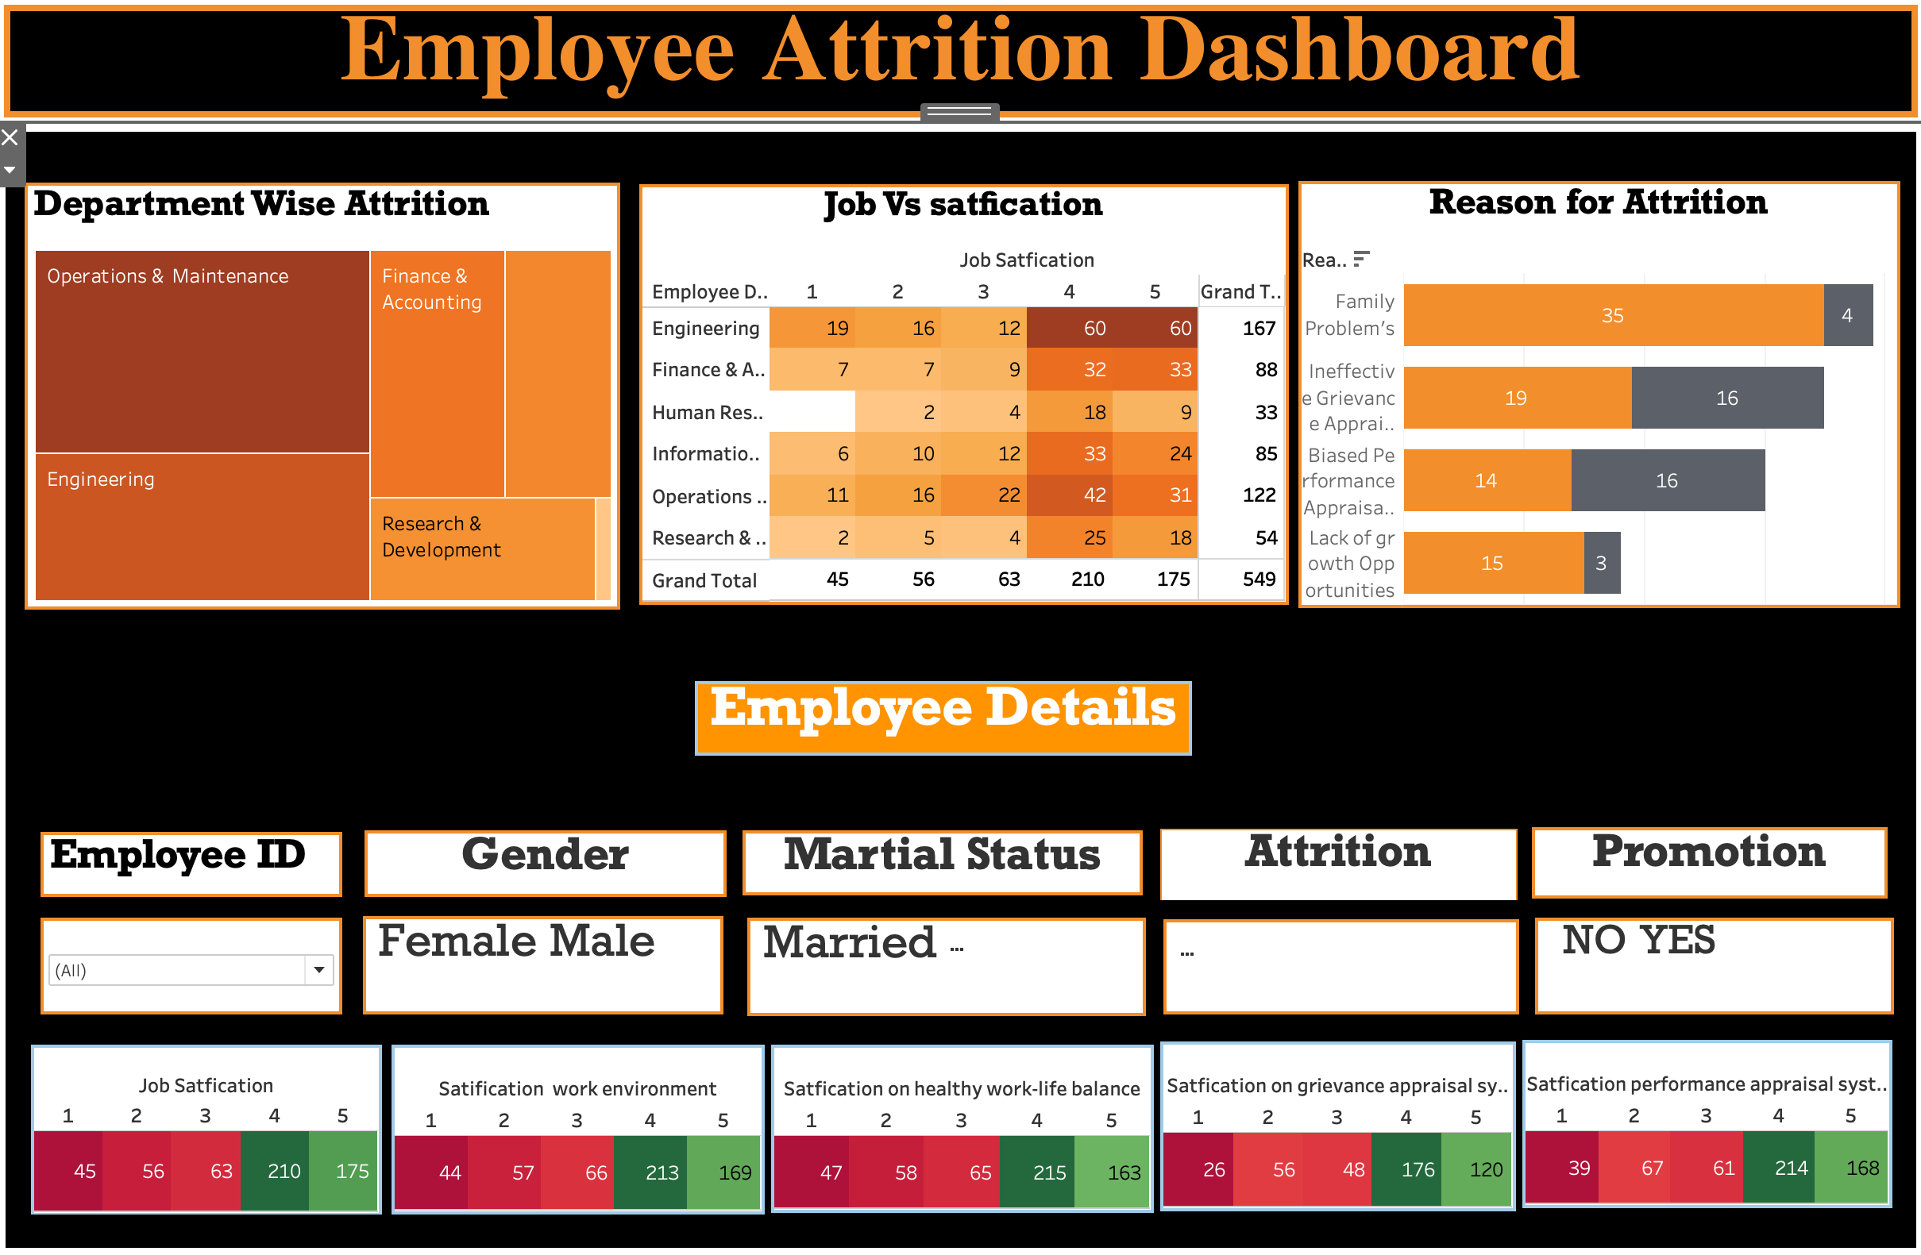

Slide 31
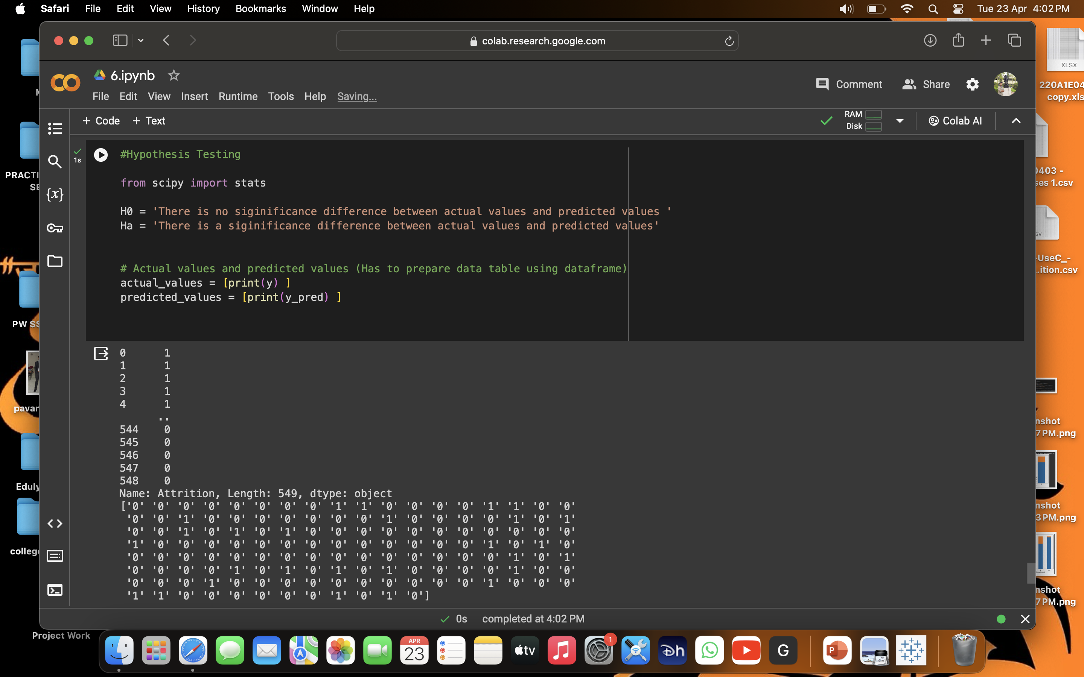
Hypothesis Testing :

Slide 32
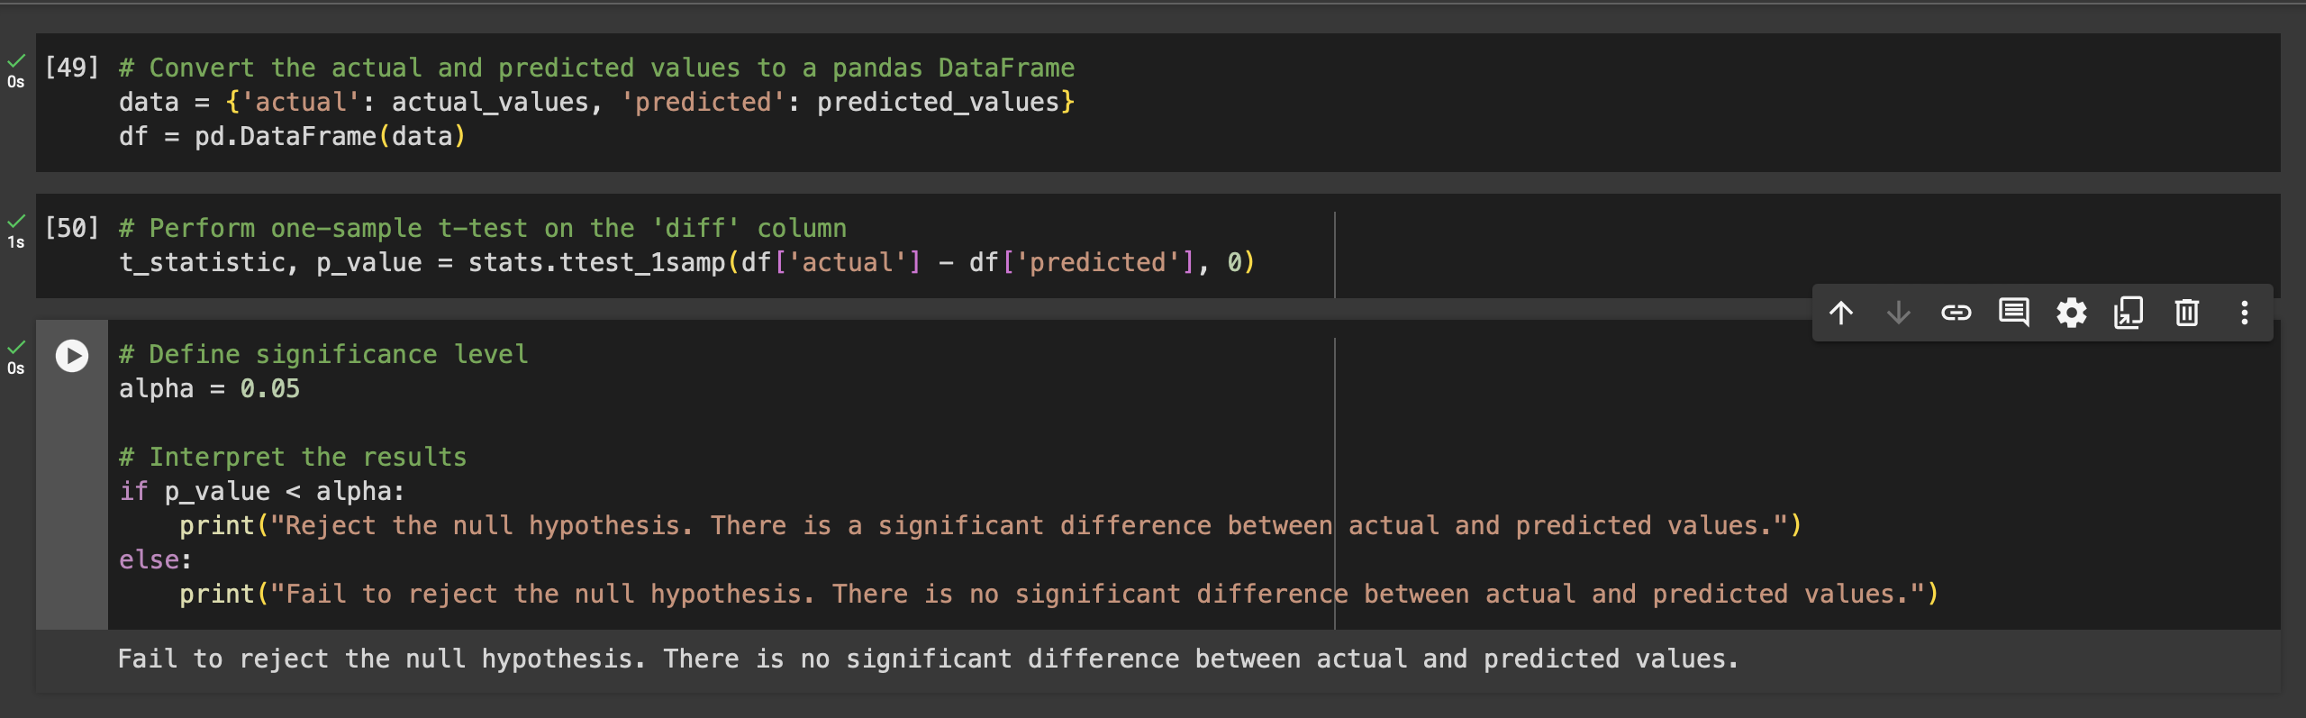
Interpretation :
Results of hypothesis testing stating that there is no significant difference between
actual values and predicted values. It means we have to accept the null hypothesis.

Slide 33
Interpretation :
Employee attrition count is 122 and employee attrition rate is 22.22.
Operations & Maintenance has the highest number of employees leaving the company (41), followed by Engineering (30) and Finance & Accounting (20).
The most common reason for employees leaving is family problem(39), followed by ineffective grievance appraisal system (35), and biased performance appraisal system (30).
Employees in Engineering are the most satisfied with their jobs, followed by Information Technology (33) and Human Resources (33)

Slide 34
Findings :
By Conducting Bi-variant analysis identified that job satisfaction, performance appraisal system, and work-life balance factors are strongly associated with employee attrition.
Random forest model gives accuracy score of 0.97,which indicates that random forest is best model among remaining models (Logistic regression(77%) and Feedforward neural networks (77%).
Achieved accuracy of 97% in predicting employee attrition, indicating the effectiveness of the predictive model.
Employee attrition count is 122 and attrition rate is 22.22 %.
Reason behind the most of the employees leaving organization is dew to family problems(39).
Discovered that operations and maintenance departments have higher attrition rates due to factors like workload, ineffective grievance appraisal system(35).

Slide 35
Suggestions :
The project establishes a data-driven approach to employee retention. This allows company to move beyond intuition an d focus on measurable factors that impact employee decisions.
Most of employee attrition is happen due to ineffective grievance appraisal system and performance appraisal system company has to relook and solve this both issues.
Company can introduce HR analytics for all people related activities.
It suggested that to Conduct exit interviews with departing employees to understand their reasons for leaving and gather valuable feedback. Analyze this feedback to identify common themes and areas for improvement within the organization.
Regularly assess employee satisfaction and engagement through surveys and feedback mechanisms. Use this data to identify areas for improvement and implement changes accordingly.

Slide 36
Conclusion :
Our project on employee attrition at PLR projects Pvt. Ltd., has provided actionable insights for the organization, enabling proactive intervention strategies to mitigate attrition risks. Through comprehensive data analysis, we have identified several key predictors of employee attrition, including but not limited to job satisfaction, tenure, salary, and performance ratings. The project highlight factors influencing employee attrition. This knowledge allows companies to develop targeted retention strategies, fostering a more engaged and productive workforce. We have successfully developed a robust predictive model that utilizes machine learning algorithms to forecast employee attrition with a high degree of accuracy. This model serves as a valuable tool for identifying employees at risk of leaving the organization. By leveraging these insights, the company can implement targeted retention initiatives tailored to the needs of at-risk employees.

Slide 37
By identifying employees at risk of leaving, companies can take proactive steps to retain them. This can save significant costs associated with recruitment, training, and lost productivity. The project establishes a data-driven approach to employee retention. This allows company to move beyond intuition and focus on measurable factors that impact employee decisions.

Slide 38
Thank you

